Slide 1
Utilizing Citizen Science to Identify Diffuse Galaxies
Nicolas mazziotti
University of Arizona
Arizona space GRANT CONSORTIUM
APRIL 20, 2024
Mentors:
prof. David sand
dr. Michael jones

Slide 2
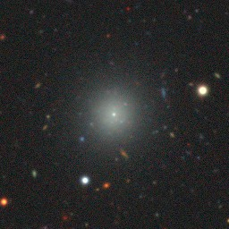
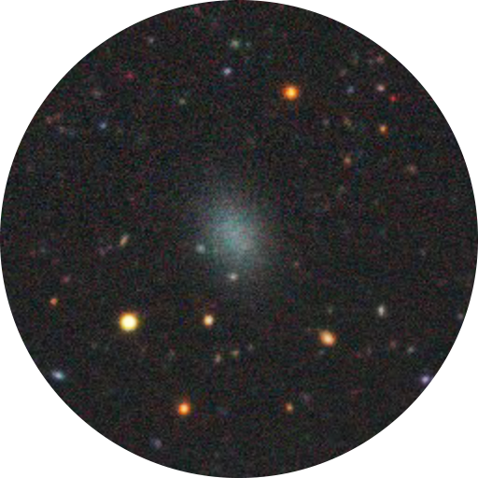
What are diffuse galaxies (DGs)?
Type of dwarf galaxy
Properties:
Half-light radius of ~1 kiloparsec
Low density of stars
Can have a nuclear star cluster
Evolutionary history not well understood
Nucleated
Non-nucleated
(Image Credit: Dark Energy Camera Legacy Survey)

Slide 3
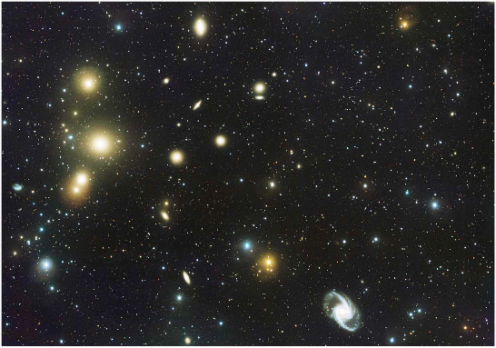
Using Zooniverse to examine the Fornax Cluster
Fornax is a large, nearby galaxy cluster
Optical data taken from the Fornax Deep Survey (FDS) and the Dark Energy Camera Legacy Survey (DECaLS)
Can examine through Zooniverse!
(Image Credit: VLT Survey Telescope)

Slide 4
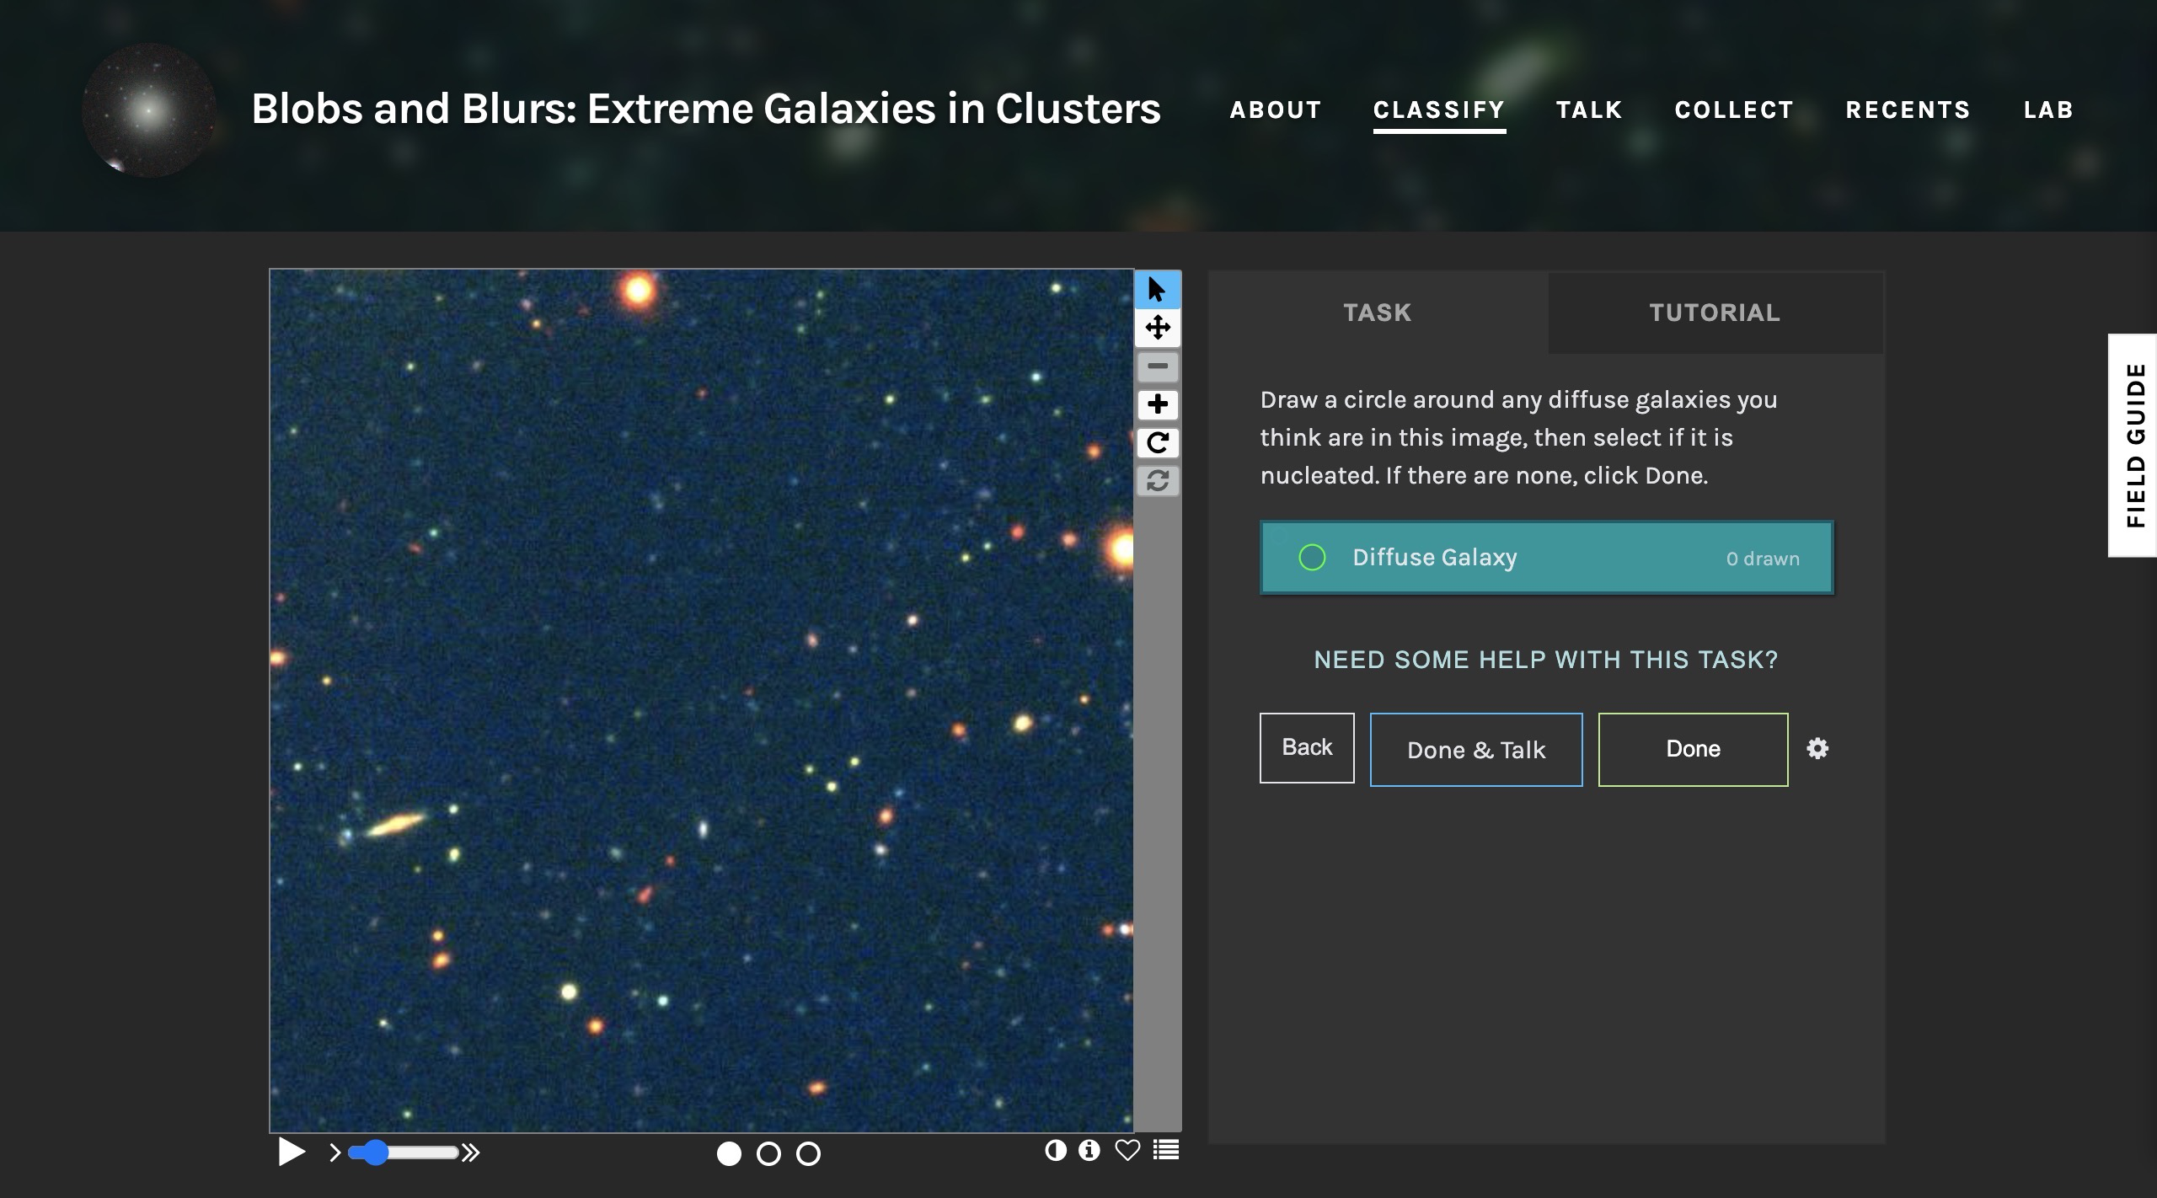
Blobs and Blurs: Extreme Galaxies in Clusters
Launched: June 6, 2023
14,976 images
Participation from over 1000 volunteers
Completed in approximately 1 month

Slide 5
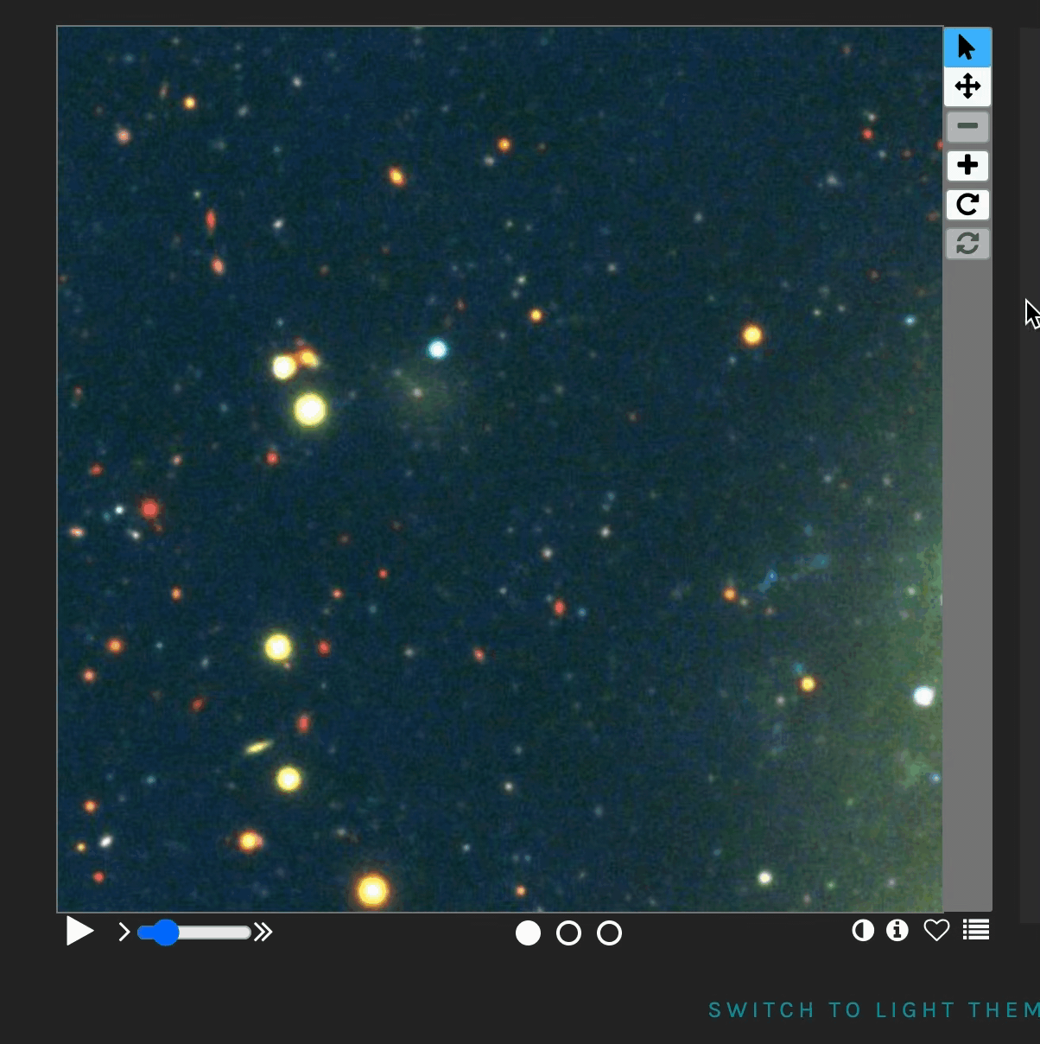
Workflow
We prompted volunteers to do the following:
Draw a circle around any diffuse galaxies you think are in this image, then select if it is nucleated.
Must be identified by at least 4 volunteers to be considered a diffuse galaxy candidate

Slide 6
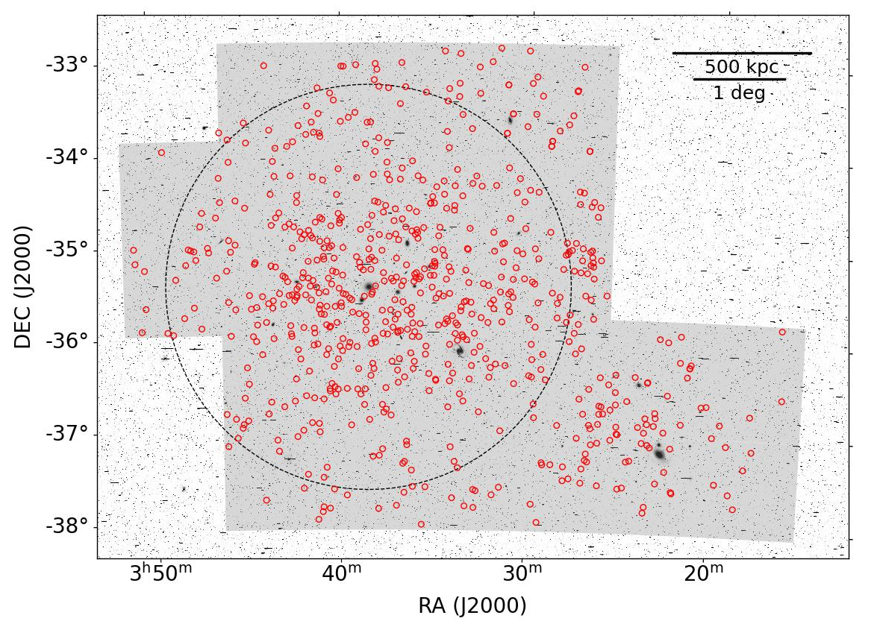
Results: Diffuse Galaxy Candidates
Over 600 diffuse galaxy candidates!
= Diffuse galaxy
candidate
+
+
= Cluster center
= Virial radius
= Observing region

Slide 7
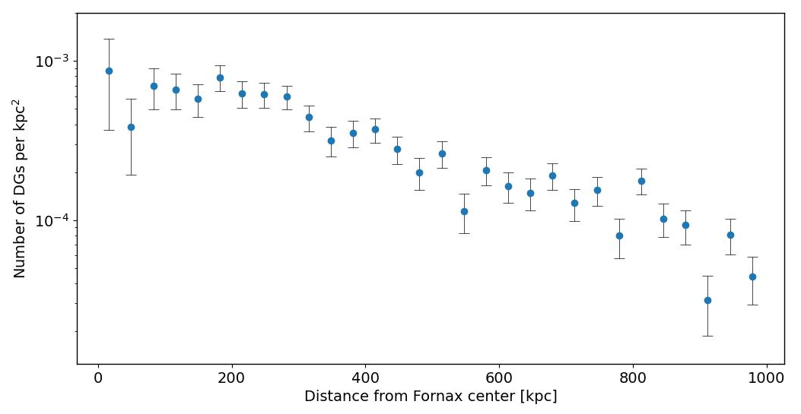
Radial Density Profile of DGs
Indicates distribution of diffuse galaxies in Fornax
Density is decreasing with distance from cluster center

Slide 8
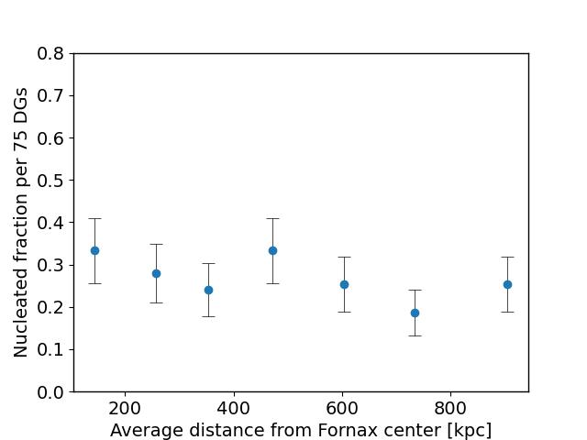
Nucleated Fraction Distribution
Nucleated fraction is the percentage of nucleated DGs in a given population
Hovers around 20-35% with increasing distance from cluster center

Slide 9
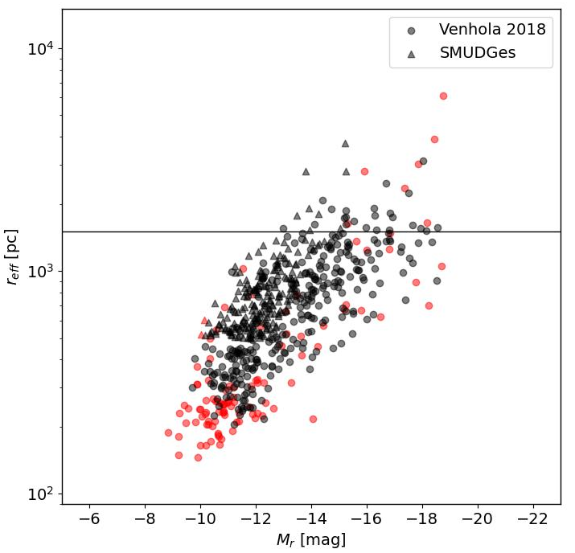
Comparison with Automated Catalogs
Found 80-98% of the same objects as automated catalogs
Missed mostly small, compact objects (boxed region)
UDG cutoff
Black = Found in automated catalog
Red = Missed in automated catalog

Slide 10
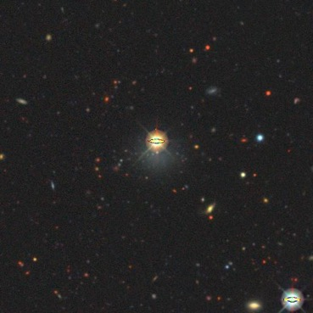
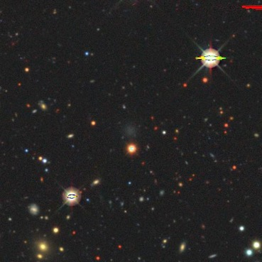
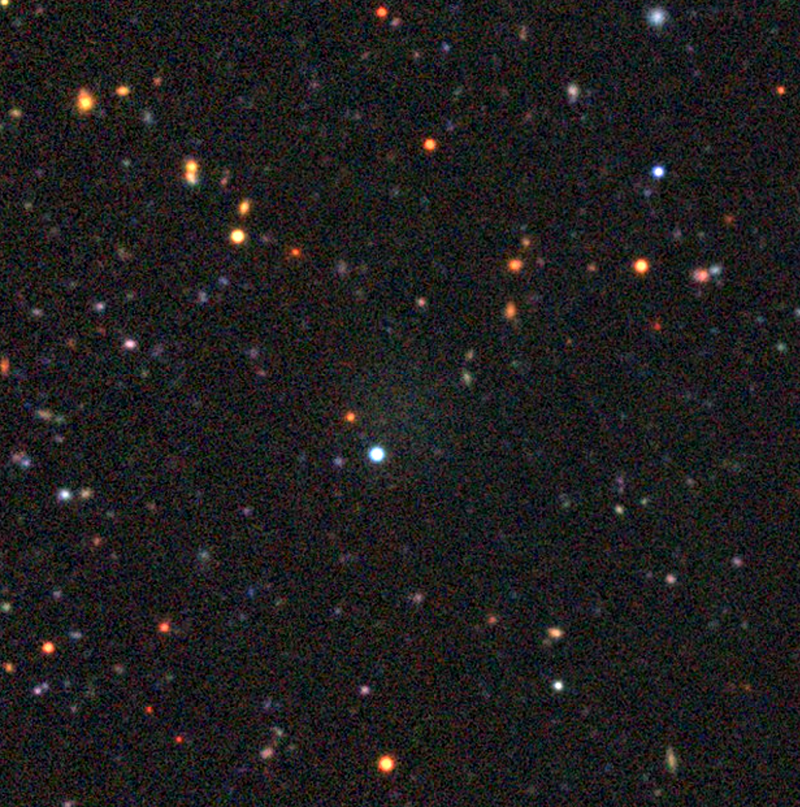
Missed by automated catalogs that we found
More than 50 diffuse galaxies were missed by automated catalogs that we found!
Examples

Slide 11
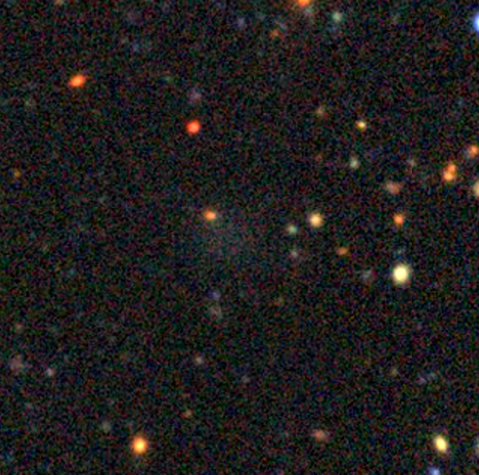
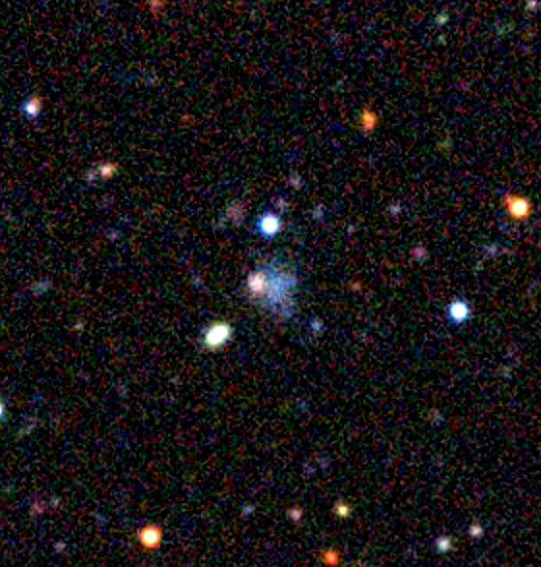
Most exciting: Four previously unknown diffuse galaxy candidates!

Slide 12
Future Work
Fitting the structural parameters of all our candidates
Publishing our final catalog
Recently completed another search in the Virgo galaxy cluster with nearly 50,000 subjects!

Slide 13
Thank you!
Acknowledgements:
Prof. David Sand and Dr. Michael Jones, Department of Astronomy and Steward Observatory
Arizona Space Grant Consortium
NASA
Zooniverse + volunteers!

